Slide 1
F# in Academia Going cross-platform with F# for MonoDevelop
Tomas Petricek
tomas@tomasp.net
http://tomasp.net/blog

Slide 2
F# doesn’t work
on Mac & Linux

Slide 3
F# doesn’t work well
on Mac & Linux

Slide 4
F# developer tools don’t work
on Mac & Linux

Slide 5
F# has great developer tools
on Mac & Linux
Introducing F# add-in
for MonoDevelop

Slide 6
F# in Academia
Good cross-platform developer tools for F#
Using cross-platform MonoDevelop IDE for Mono
F# add-in provides IntelliSense and F# interactive
Not aimed at large-scale business applications
Demonstration – how can universities use F#?
Teaching (functional) programming
For statistics and data analysis
Functional programming research

Slide 7
Teaching (functional)
programming with F#

Slide 8
F# for Teaching
F# is a great language for teaching
Practical functional programming
Programming language concepts and principles
Introducing computer programming
Introduction to (functional) programming
Solid and useful mathematical foundations
Gives students practical experience
Intriguing examples are a great motivation

Slide 9
Demonstration
Composing 3D objects in a functional way

Slide 10
Processing scientific data with F#

Slide 11
F# for Data Processing
What makes F# great for working with data?
Productive and efficient language
F# Interactive environment
Useful features such as units of measure
Many scientists use F# already
Genome sequencing, Machine learning
Can be used on multiple platforms now…

Slide 12
Demonstration
Downloading and analyzing stock data

Slide 13
Programming language research with F#

Slide 14
F# for Language Research
Building the open-source version of F#
Release contains command line tools
Integrates into MonoDevelop with no effort
Auto-completion & tool-tips “just work”
Examples of existing F# extensions
Joinads: Language extension for reactive, concurrent and parallel programming
F7: Refinement Types for F#

Slide 15
Demonstration
Adding “joinads” to F# in MonoDevelop

Slide 16
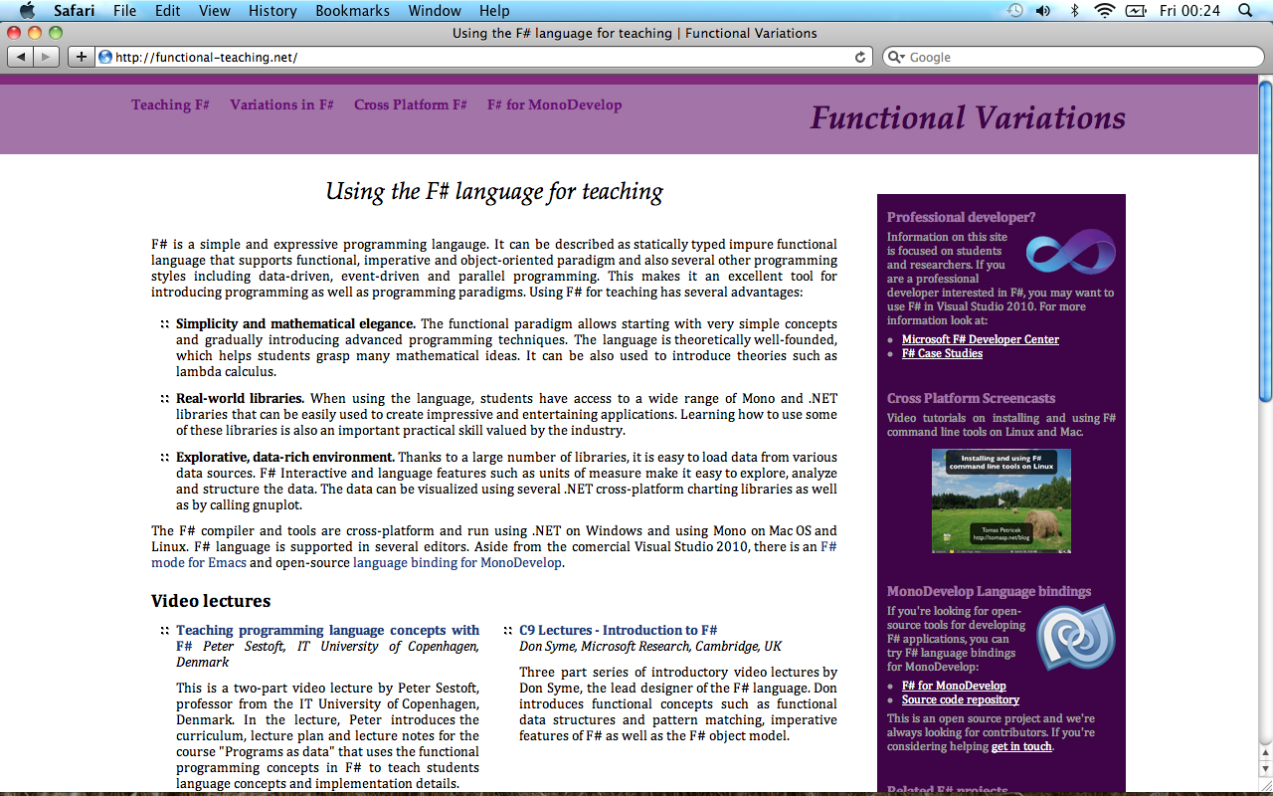
Functional Variations & Teaching
Web sites for F# in Academia
Teaching, Working, Research
Home for the MonoDevelop plug-in
Personal community project
If you’re interested, please get in touch!
Two addresses to remember
www.functional-teaching.net
www.functional-variations.net

Slide 17
Summary
F# is a great language for Academia
Consistent cross-platform feel with MonoDevelop
Lightweight, but with all modern features
Uses of F# in Academia
Teaching (functional) programming
Data analysis and statistics
Programming language research

Slide 18
Links
Contact: Tomas Petricek
Mail: tomas@tomasp.net
Web: http://tomasp.net/blog
Get involved!
http://functional-variations.net
http://functional-teaching.net

